Slide 1
Cardiovascular Disease Prediction FINAL PROJECT PRESENTATION CMPE 255 SPRING 2022 UNDER GUIDANCE OF PROF. KAIKAI LIU
PRESENTED BY:-
SAI SWARUP RATH- TEAM 16
(014655446)

Slide 2
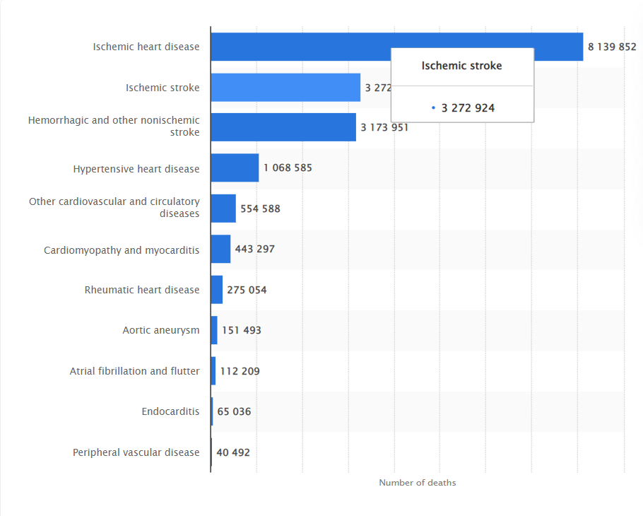
Motivation
There were over 8 million deaths from ischemic heart disease making it the most deadly cardiovascular disease(CVD).
CVD Prediction is one of the most effective measures for CVD control.

Slide 3
Role of Data Science
AI and Machine learning enables algorithms to understand and learn data.
These trending technologies are applied in cardiovascular medicine including :
Precision medicine.
Clinical prediction
Cardiac imaging analysis
Intelligent robots

Slide 4
Objectives
Gather the insights from the dataset provided
Dataset- Name:- Cardiovascular Disease Dataset
Source:-https://www.kaggle.com/sulianova/cardiovascular- disease-dataset
● Size of data:- 70000 records and 12 features.
Predict the possibility of a person having Cardiovascular disease based on the various parameters specified in the dataset.

Slide 5
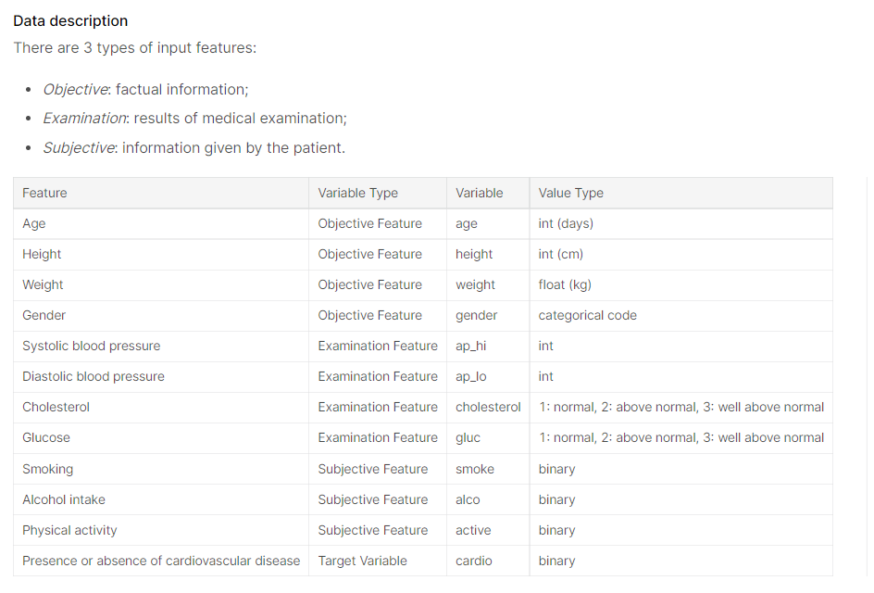
DataSet
DataSet Size :- 70000 rows

Slide 6
Exploratory Data Analysis and Data Preprocessing
Count of categories in Categorical variables. (countplot)
Age v/s Cardiovascular. (kdeplot)
Age Groups v/s Cardiovascular. (By binning the age)
All categorical feature v/s Cardiovascular. (histplot)
Correlation matrix using heatmap.

Slide 7
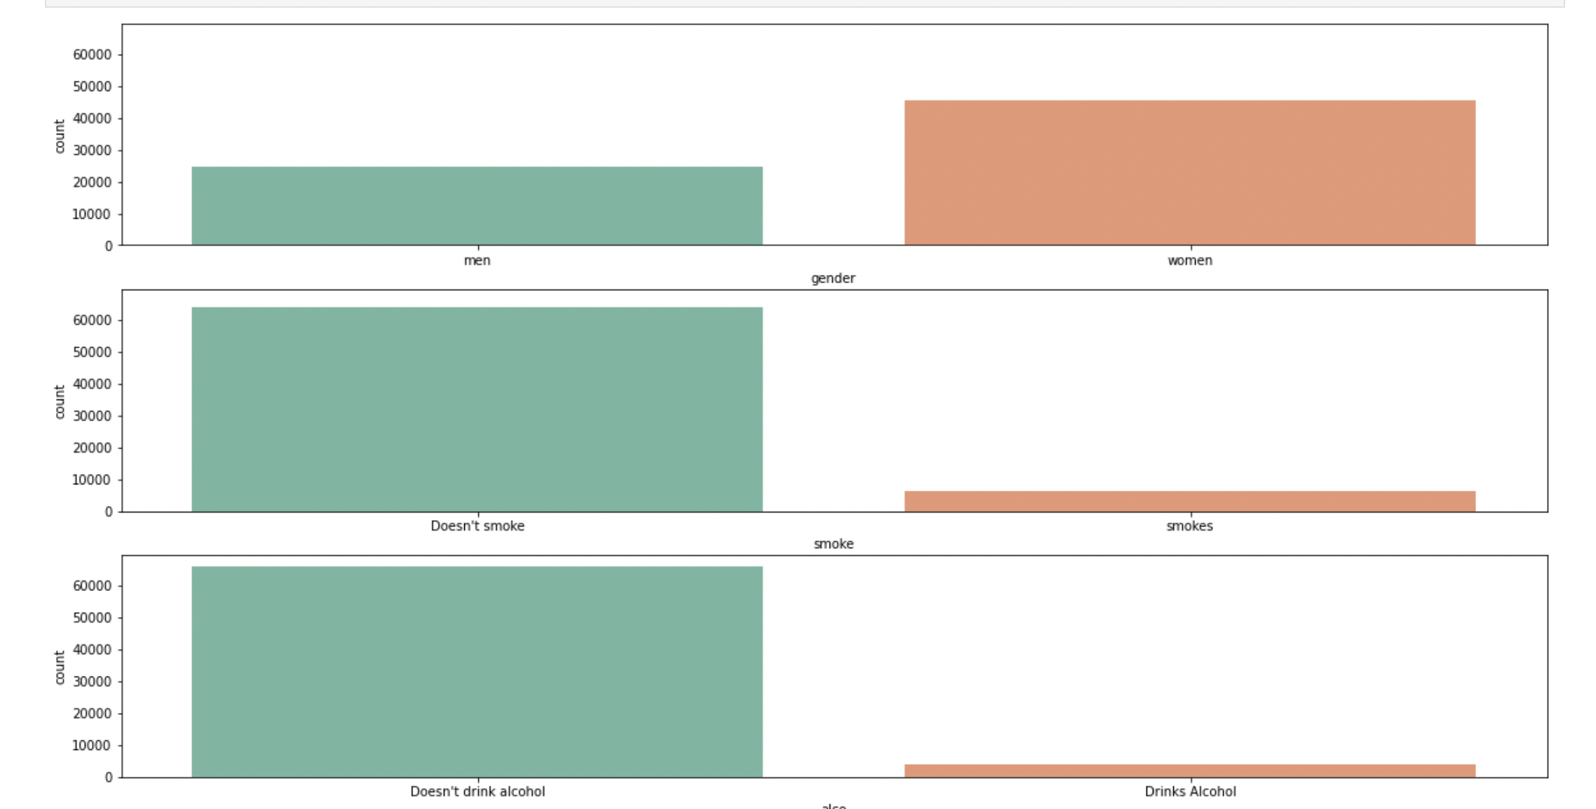

Slide 8
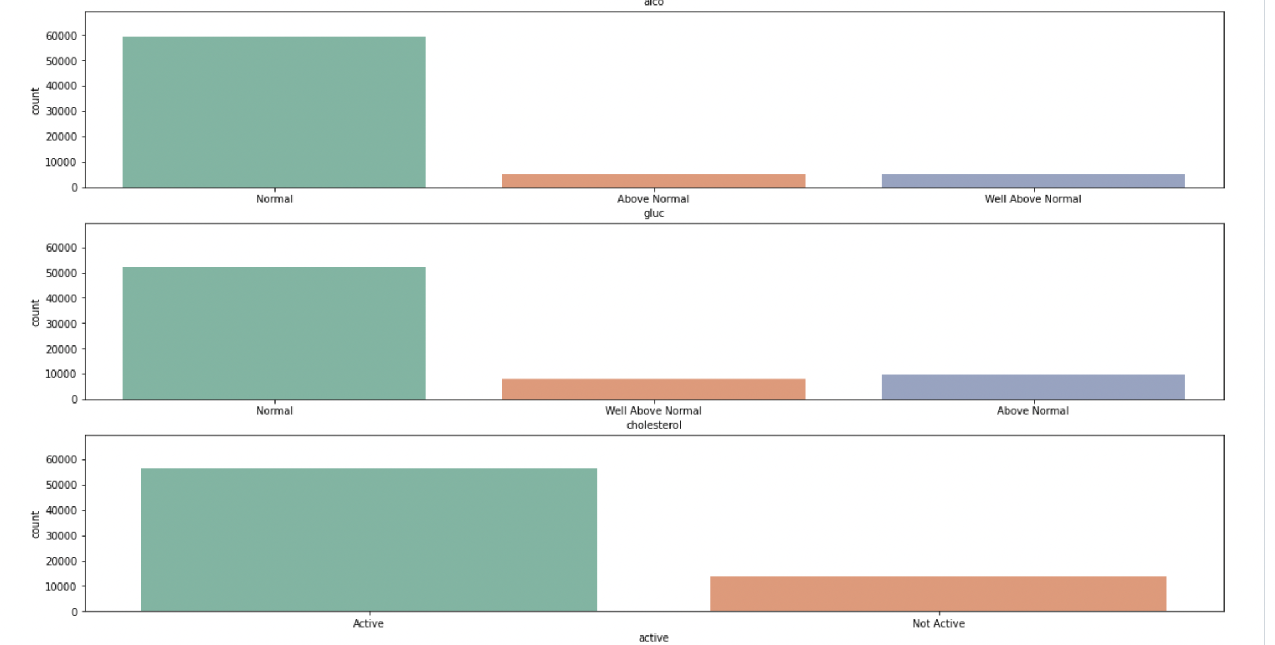

Slide 9
Univariate Analysis
From the countplot we can see that we have:
Twice the data of women than men.
More than six times the data of people who don’t smoke than people who smoke.
More than seven times the data of people who don’t drink alcohol than people who drink alcohol.
More than seven times the data of people who have normal glucose and normal cholesterol than people having above normal glucose and cholesterol.
More than five time the data of people who are active than who are not active.

Slide 10
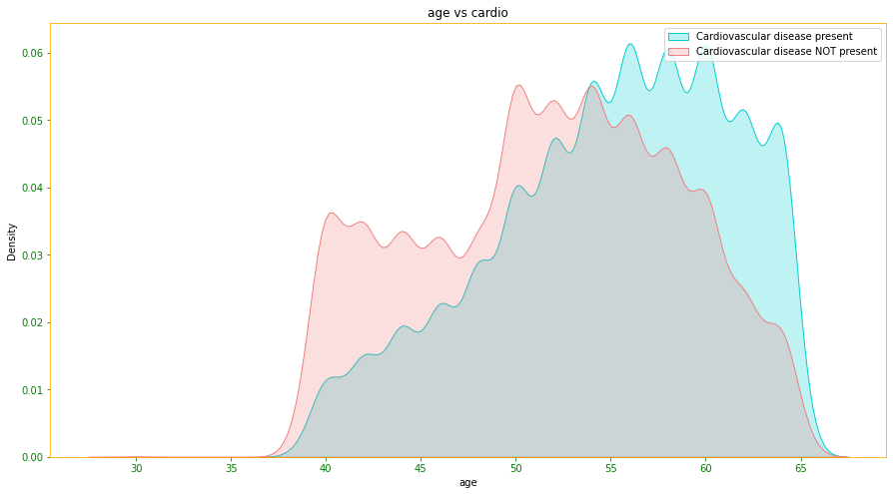
Bivariate Analysis
People over 55 years of age
are more exposed to CVD

Slide 11
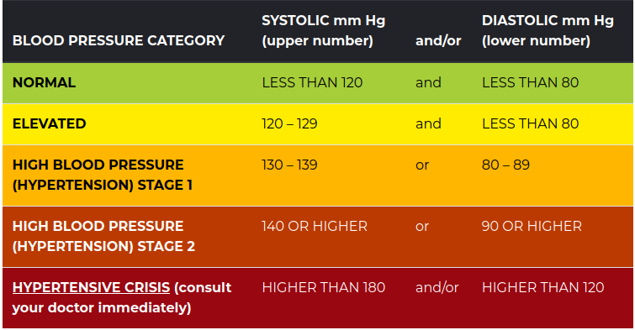
Outliers
Systolic Blood Pressure (ap_hi) Diastolic Blood Pressure (ap_lo)
70-240 40-180

Slide 12
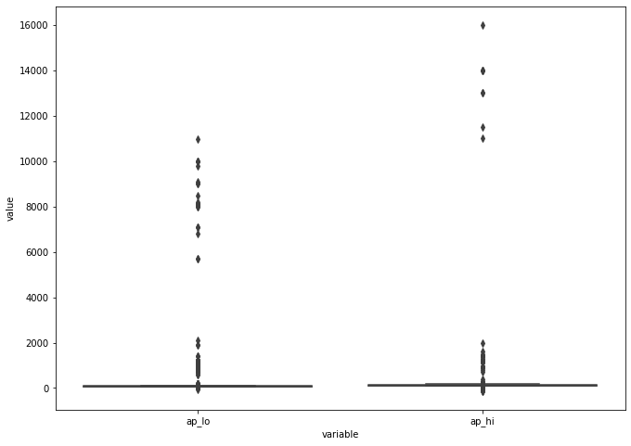
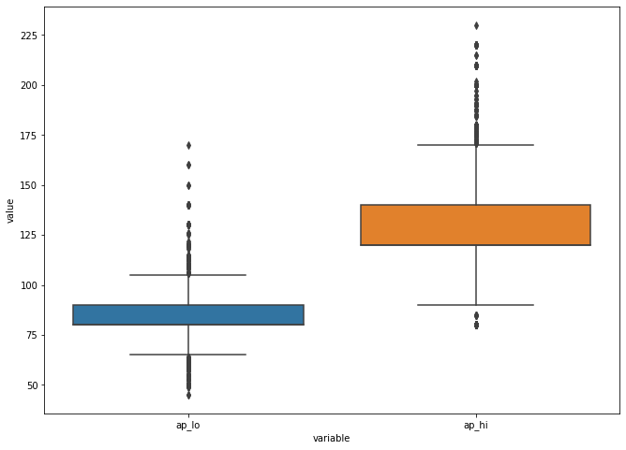
Outliers
Before
After

Slide 13
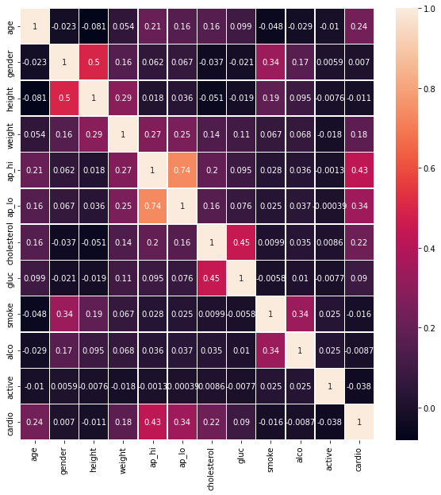
Correlation Matrix

Slide 14
Data Transformation
Feature engineering by creating a new feature BMI from weight and height.
Normalization using MinMaxScaler.
Perform One-Hot Encoding (Gender, Cholesterol and Glucose)

Slide 15
Models Used
Logistic Regression
Support Vector Machine(SVM)
K-Nearest Neighbors(KNN)
Neural Network
Random Forest
XGBoost
AdaBoost

Slide 16
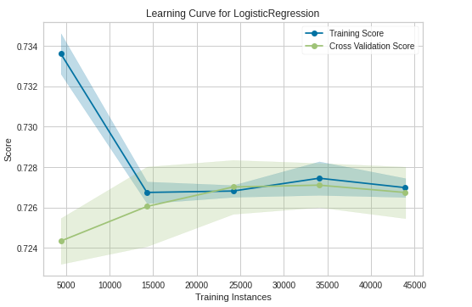
Logistic Regression
Supervised Machine learning algorithm used for classification
Accuracy Achieved - 73.3%
Advantages -
Easy to implement
Does not require high computational power
In low dimensional dataset less prone to overfitting
Disadvantages -
High dimensional dataset may lead to overfitting
Non linear problems can’t be solved
Sensitive to outliers

Slide 17
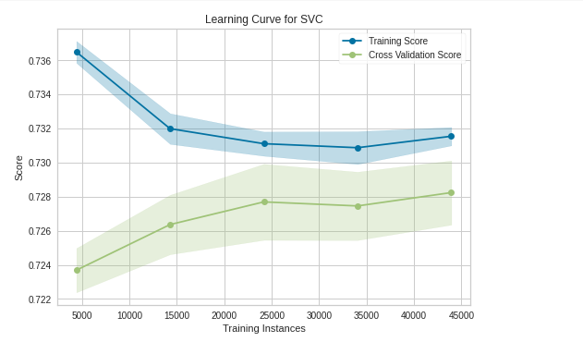
SVM
Supervised Machine learning algorithm can be used for both classification and regression. We perform classification by finding a hyperplane which separates the two classes.
Accuracy Achieved - 73.7%
Advantages -
More effective in high dimensional dataset
Can be used for both classification and regression
Disadvantages -
Not suitable for large data sets
Costly computation

Slide 18
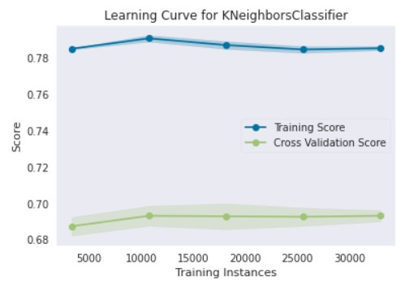
KNN
Accuracy Achieved - 71.89%
Advantages -
1. Instance based learning and hence, is faster than SVM etc.
2. New data can be added seamlessly.
Disadvantages -
1. Requires feature scaling
2. Doesn’t work well with high dimensional data

Slide 19
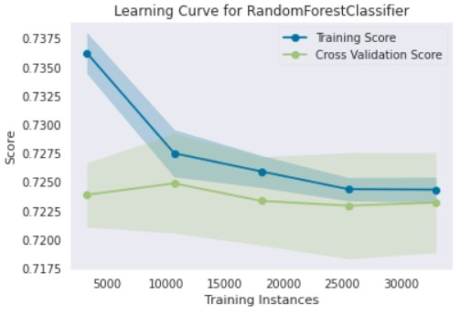
Random Forest
Accuracy Achieved - 72.9%
Advantages -
1. Bagging technique, less prone to overfitting.
2. Comparatively less impacted by the noise.
Disadvantages -
1. Computationally expensive

Slide 20
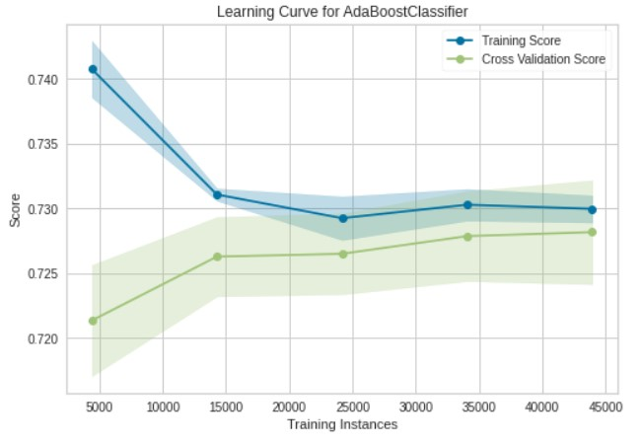
AdaBoost
Accuracy Achieved - 72.64%
Advantages -
Less prone to overfitting.
Disadvantages -
Requires quality dataset.

Slide 21
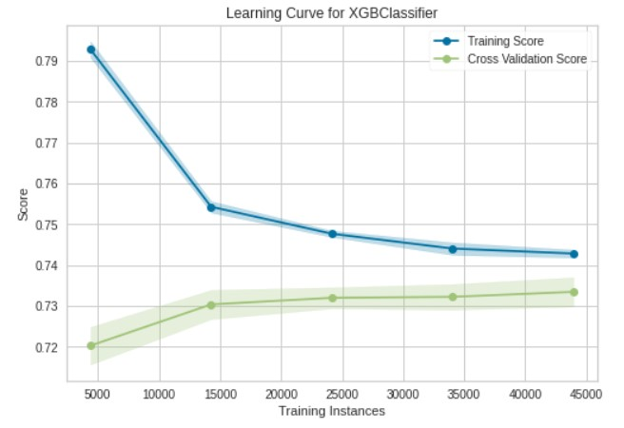
XGBoost
Accuracy Achieved - 73.28%
Advantages -
1. Supports regularization and faster than other gradient boosting algorithms.
2. Can run cross-validation after each iteration.
Disadvantages -
1. Doesn’t perform well on sparse or unstructured data.

Slide 22
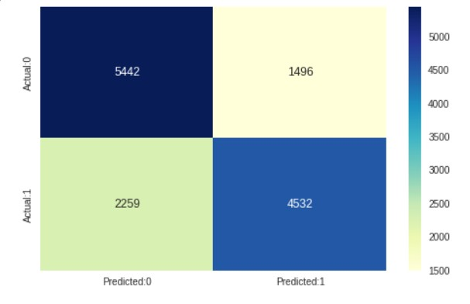
NN
Accuracy Achieved: 73.7%
Advantages:
1. Ability to learn by itself and produce the output that is not limited to the input provided to them.
Disadvantages:
1. BlackBox Nature.
2. Computationally expensive.
3. Can easily Overfit.

Slide 23
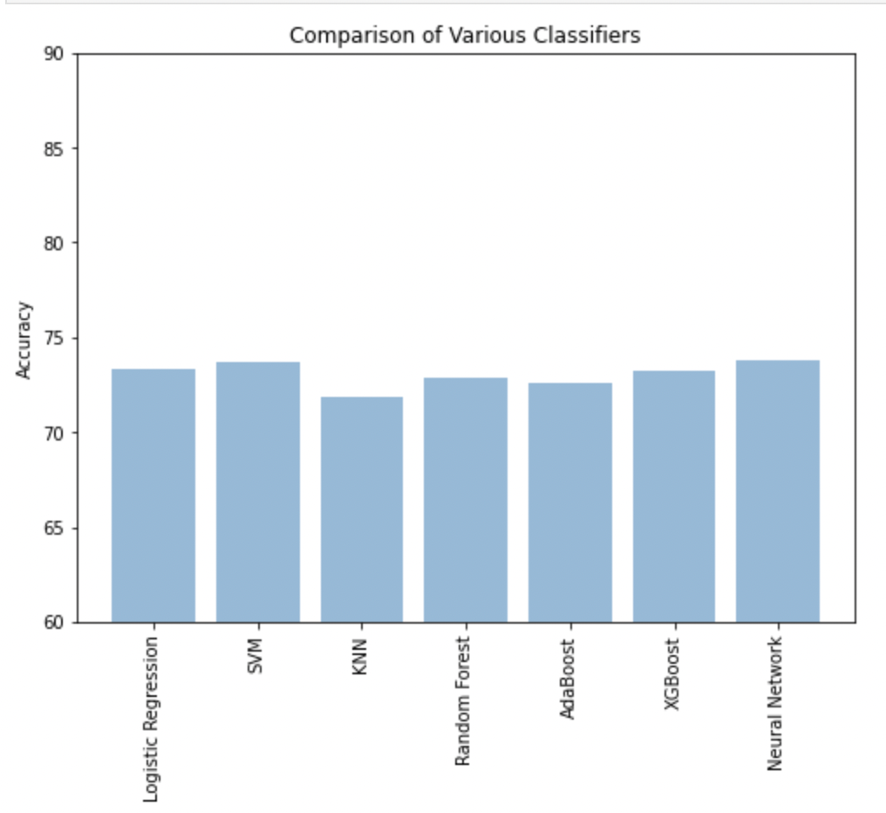
COMPARISON OF VARIOUS CLASSIFIERS

Slide 24
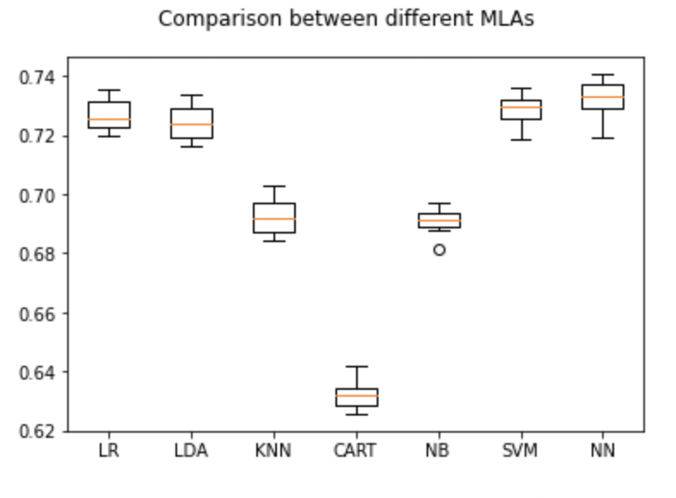

Slide 25
Feature Transform
Process to modify the data but keep the information.
Tried with degree varying from 1 to 6.
Result:
No significant improvement
Similar accuracy with all the models

Slide 26
Challenges Faced & Conclusion
Less number of records for people who drink and smoke.
Dataset requires more attributes to improve the accuracy of prediction.

Slide 27
Thank you!

